Slide 1
Is There Really Only One Way? Rethinking Assessments with UDL in Mind
Veronica Womack
Searle Center for Advancing Teaching and Learning
Jim Stachowiak
AccessibleNU
Notes:
15 min (from slide 1-8) including time of them getting settled in room

Slide 2
Learning Objectives
You will identify assumptions that serve as the basis for the design of current assignments and assessments.
You will apply at least one UDL-based approach to their class to reduce student anxiety around exams and deadlines while maintaining rigor.
You will critically examine course learning objectives to eliminate unnecessary components that restrict offering assignment options.
You will apply the UDL principle of multiple means of expression by redesigning one assignment to offer at least two options of delivery.

Slide 3
Defining ‘Multiple Means of Expression’
The multiple ways that teachers can formatively or summatively evaluate students, as well as engage students in self-evaluation.¹
There is no one means of action and expression that will be optimal for all learners; providing options for expression is essential.²
¹ Kieran, L., & Anderson, C. (2019). Connecting universal design for learning with culturally responsive teaching. Education and Urban Society, 51(9), 1202-1216.
² CAST UDL Guidelines
Notes:
Learners differ in ways they can navigate the learning environment and express what they know.
Expression requires a great deal of strategy, practice, and organization.

Slide 4
Pre-Session Reflections
Do I expect my students to demonstrate that they are experts or that they are continual learners?
Am I asking my students to articulate their ‘mastery over’ the content or their ‘relationship with’ the content?
Am I prioritizing ‘learning in isolation’ over ‘learning in collaboration with others’ ?
Do my assignments indicate my commitment to on-going learning, reflecting, and revisions for myself and my students?
Notes:
This questions can help us unpack assumptions that we may have about our students in relation to how they are assessed

Slide 5
Considerations When Centering
Culture & Inclusion in Your UDL Practices
Be aware of your students as individuals
Actively address how power and privilege shape and block learning opportunities
Build empowered communities of “expert learners”
Notes:
This questions can help us unpack assumptions that we may have about our students in relation to how they are assessed

Slide 6
Approaches to Learning
Banking Model
vs.
Liberatory Model

Slide 7
Approaches to Learning
“Banking Model”
students = passive consumers
should consume and memorize information disseminated by professor
professors have nothing learn from students
Adapted from hooks, Teaching to Transgress: Education as the Practice of Freedom

Slide 8
Approaches to Learning
“Banking Model”
students = passive consumers
should consume and memorize information disseminated by professor
professors have nothing learn from students
“Liberatory Model”
everyone in the classroom
is an active participant
brings knowledge and expertise, not just the instructor
invited to participate as full people
knowledge is co-created by all participants through activity and dialogue
Adapted from hooks, Teaching to Transgress: Education as the Practice of Freedom

Slide 9
Connecting Multiple Means of Expression and Culturally Responsive Teaching
honoring different methods of students’ sharing knowledge (i.e. storytelling, family histories) and valuing experiential knowledge and traditions
providing opportunities for collaboration and reciprocal teaching
acknowledging both Standard English and local discourse styles
using metacognitive strategies to change students’ negative thought processes when they encounter learning challenges
Kieran & Anderson, 2019
Notes:
Highlight why we prefer this model
Read all 4 and elaborate on 2

Slide 10
Expression of Learning Opportunities Worksheet
Opportunities | Formative Assessment | What is the delivery methods for this assignment | Summative Assessment | Describe the format for this exam and why this is used?
… to state relayed information
…to demonstrate inquiry
…to reflect
…to revise
…to practice skill sets
…to collaborate with others

Slide 11
Small Group Discussion Questions
Describe how it felt to critically review your own assessments?
What did you notice about your assignments and exams ?
Did you recognize any hidden assumptions about your students? OR Were any assumptions uncovered?
If so, where do you think these assumptions came from?
Notes:
15 min break out + 5 min debrief

Slide 12
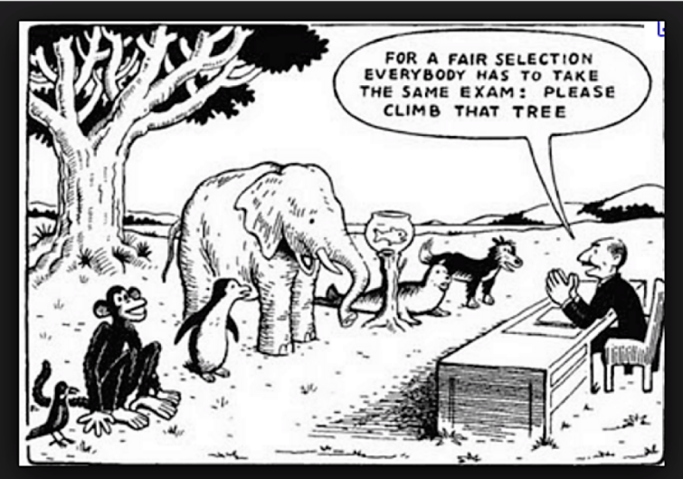
UDL and Assessments

Slide 13
UDL and Exams
Why Exams? Why This Way?
Exams are a significant stress for students, but also part of the college experience
Why do you give exams?
Why use the format you use?
Is there another way?
Offer Flexibility
Allow for makeups within reasonable time
Create a backup exam
Use old exams
Create exams in Canvas and draw from question banks
Give multiple chances to answer Canvas exams
Offer take home exams focusing on application
Offer a drop
Offer correction options

Slide 14
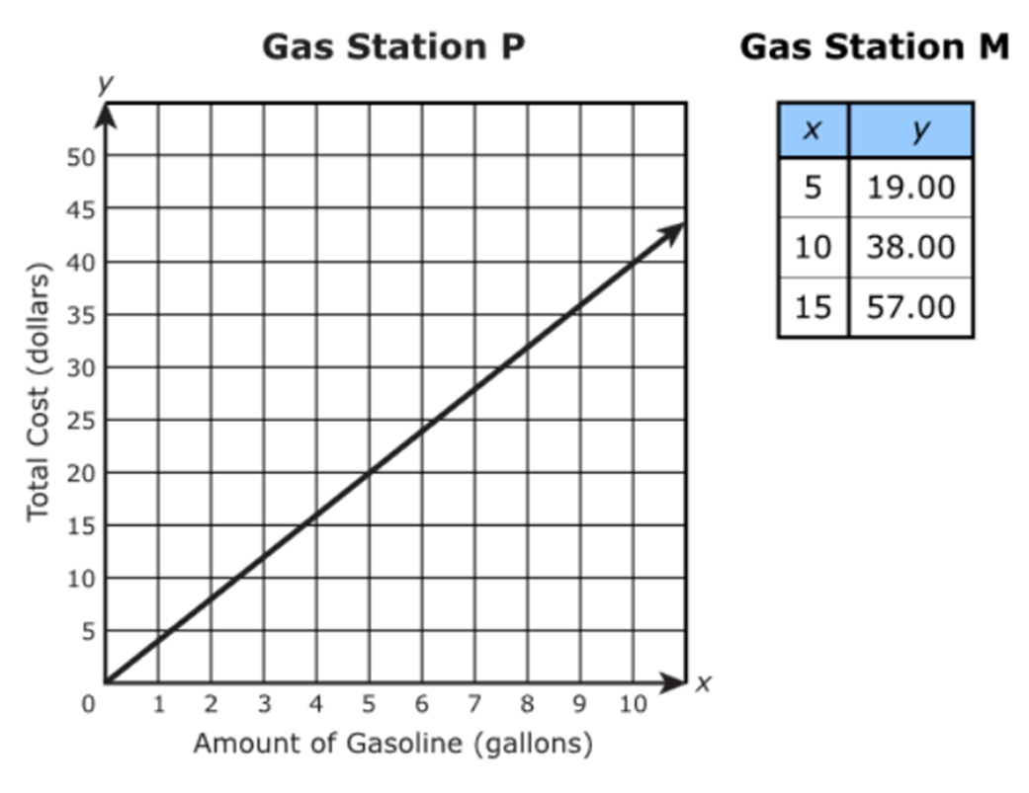
UDL and Exams
Vary Types of Questions & Offer Supports
Distribute demand and benefits of types of questions within or across exams
Consider what is being tested and offer supports where possible
Digital text
Formulas
Display info in multiple formats
Notes:
Slides 10-20 25 minutes

Slide 15
UDL, Exams, & Deadlines
Student Issues
Stress and anxiety build when students have deadlines and exams at the same time
Students tend to focus more on the exams
Assignment work suffers
Potential Solutions
Avoid due dates during midterms
Offer flexible due dates around midterms
Offer short, no question extensions, especially for late deadlines
Offer a set amount of “late” days at the beginning of the quarter that students can distribute as needed
Offer more opportunities for points than points needed

Slide 16
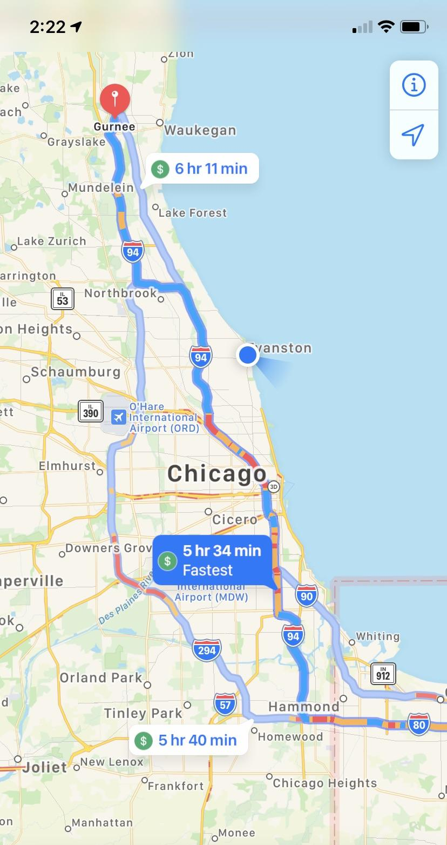
UDL & Assignments - Add Options
Use plus-one thinking to add one more option to an assignment
Potential options:
Paper
Video
Presentation
Podcast
Project

Slide 17
Why Provide Assignment Options?
We are working to create expert learners, options encourage greater engagement
Allows students to choose to develop skills or use strengths to further engage
Can remove barriers to expressing learning
Can give instructors more interesting end results

Slide 18
How Do We Offer Options?
Make sure learning objectives are clear and speak to what needs to be completed in the course.
Determine the skills (target skills) the assignment is assessing related to the learning objectives.
Determine the skills (access skills) used to complete current assignments that aren’t necessary to align with the learning objectives.
Add one option that also allows for completion of learning objectives

Slide 19
Revisit Learning Objectives
Do your current course learning objectives influence your assignment delivery method?
YES
NO
Why? Is the assignment delivery method critical to your learning objectives?
Consider using plus one thinking to add one more option to your assignment delivery method.
YES
NO
Options are not possible for this assignment
Consider rewriting your LO’s to allow options

Slide 20
Determine Target Skills
Make a list of the identified skills you are assessing for each assignment
Compare the identified skills to your learning objectives
Those that map to your learning objectives are target skills

Slide 21
Identifying Target Skills - Example
Target Skills
Identify who, what, why, and when of conflict
Clearly communicate who, what, why, where, when
Demonstrate understanding of genre conventions
Understand impact of audience life experiences
Demonstrate ability to clearly connect with intended audience
Pick a conflict in which you are invested and then introduce this conflict to two different audiences in two different genres via a written summary. Each summary should include no less than 250 words.
Whatever conflict, audiences, or genres you choose, the most important part of this assignment is that:
–The who, what, why and when of the conflict is clear
–Beyond the gist of the conflict, any other information you include will depend on your audience and the conventions of the genre you have chosen
–Think about what life experiences your readers are bringing to your text.
–Based on your word choice, the style and tone of your writing, and the images you include (or not), your intended audience should be clear.

Slide 22
Determine Access Skills
List all skills needed to complete the assignment as currently designed
Access Skill Examples
Writing
Spelling
Reading fluency
Working memory
Attention
Speaking
Cross reference list with target skills and LO’s
Anything not explicitly tied to LO’s is an access skill

Slide 23
Add Options
Start with one assignment
Add one other option with different access skills to complete
Set the technical standards for your assignment

Slide 24
What About Grading?
Develop Clear Rubrics
Develop rubrics aimed at objectives that can be observed regardless of method
Make sure students know what is and isn’t being graded
Notes:
Veronica will set up options for breakout rooms in advance.

Slide 25
Case Studies
Choose one of the following break out rooms to discuss a case study:
Room 1: Large Humanities/Social Science Class
Room 2: Small Humanities/Social Science Class
Room 3: Large STEM Class
Room 4: STEM Lab Class
Questions to Consider
What would you do in the short term to apply UDL principles to assessments in this course?
What would be potential longer term UDL solutions this instructor could implement around their assessments?
How would you address any potential difficulties or hesitancies you might experience in implementing UDL solutions in this class?
Notes:
20 min breakout group +5 min debrief

Slide 26
Addressing Hesitancies around Implementing UDL Solutions
Reflect on what your hesitancies and why they exist
Think of resources (internal and external) that will help you be open minded and creative
Think of necessary structural support from your department
Take an iterative approach, starting small and making additions over successive quarters
Seek out support from others who have implemented elements of UDL successfully

Slide 27
Questions?

