Slide 1
Beyond the Textbook
Universal Design for Learning
Multiple Means of Representation as a Path to Removing Barriers
Christine Scherer, Sr. Instructional & Learning Accessibility Specialist
Lauren McKeen McDonald, Open Education Librarian
Notes:
Introductions
Remember to visit the Parking Lot to leave your thoughts and feedback on previous sessions–and stop in after this one to share what you think about this one?
Reminder that the session is being recorded.
Christine Scherer (she/her) is the Senior Instructional & Learning Accessibility Specialist in the Office of Distance Learning in the School of Professional Studies. She supports the rest of the DL team in online course creation by ensuring that all courses meet appropriate standards for writing quality, copyright, and accessibility. She’s created numerous training materials and workshops on accessibility and UDL for instructors and staff.
Lauren McKeen McDonald (she/her) - I am the Open Education Librarian here at Northwestern. I work with faculty and instructors to find and create suitable OER for their course. I also have a special interest in open pedagogy, and can assist instructors to develop lesson plans and curriculum that utilize the power of open licenses. In addition to open education, I also support the research and teaching needs of the Communication Studies department as their library liaison.

Slide 2
What is Multiple Means of Representation?
Presenting information in multiple formats, such as text, audio, visual, images, interactive activities, and more.
“There is not one means of representation that will be optimal for all learners; providing options for representation is essential.” - CAST
Notes:
Christine: Multiple means of representation is about how the instructor presents information to the students. This UDL principle asks that, instead of presenting a piece of information in a single format, you present it to students in multiple ways, be it through text, audio, video, images, interactions, and more. Why do this? Because, to quote CAST, “there is not one means of representation that will be optimal for all learners.” For example, not everyone is going to learn best from a video: they may be Deaf or hard of hearing and have trouble following along, they may not have time to watch a lengthy video, they may have an attention disorder that makes it hard for them to focus, they may simply prefer to read rather than listen and watch. By providing a video with descriptive audio, captions, and a text transcript, you’ve given students three options: they can watch the video (with or without captions), they can listen to the audio only, or they can just read the transcript. They get the same information, but in the format that works best for them.

Slide 3
Why is it important (especially now)?
As the pandemic and additional social crises continue, students are dealing with:
Brain fog
Memory and concentration issues
Burnout
Higher rates of anxiety and depression
Increased out of school responsibilities (work, family, childcare)
Long COVID symptoms
All of these can make “traditional” resources (like textbook chapters) challenging!
Notes:
Christine: The pandemic and other crises (police violence against Black and brown Americans, rise of white supremacy, gun violence, economic stress of increasing prices and stagnant wages, international crises) have put incredible stress on us all, students included. Over the last few years, students, disability resource centers, counseling centers, and instructors have reported an increase in these challenges. All of these can make any one resource, but especially traditional resources like lengthy textbook chapters, a challenge to engage with.

Slide 4
How can it benefit instructors?
Increased student participation in class discussions
Crowdsource resources from students
Build resource library that can be reused in future classes
Notes:
Christine: Including multiple means of representations in your course might seem like extra work, especially after we just talked about all the stress we’re all under! But there are many benefits to expanding the resources you use in your course. First, you’ll likely see a reduction in the number of students who “didn’t do the reading” and don’t participate in class discussions. If you have more options for resources, then students will be more likely to find a format that they can engage with. Second, you can build up a library of future resources, by crowdsourcing resources from students or developing reusable resources (like short videos or graphics) that you can use across multiple courses.

Slide 5
What barriers might exist within your resources?
Notes:
https://www.mentimeter.com/features/word-cloud

Slide 6
Practical Implementation
Before
During &
After Class
Consider: Where are you only providing resources in a “single stream” of content, or in just one way?
Photo by Nathan Anderson on Unsplash
Notes:
Lauren
Now it’s time to dive in to some practical applications of multiple means of representation within your classes. There are many strategies for updating your courses, and some take more time than others. In thinking about the best way to share these strategies, we’ve organized them as things you could do BEFORE, DURING, and AFTER class. Some of the tips will fit roughly into these categories, or could be done at anytime during your course creation and instruction; we encourage you to implement the strategies we’ll share at whatever point makes most sense to you.
As you may have already learned in the practicum so far, we’re taking a plus one approach to UDL. When you think about your course materials and various representations or ways of presenting information, pay attention to those areas in which you’re presenting information in a single stream. In other words, when are you providing or presenting content in just one way? We’ll use that as our starting point to begin making updates.

Slide 7
Getting Started - Before Class
Review your course materials for single stream elements
Consider how the single stream elements intersect with the barriers or pinch points you’ve identified within your course
Brainstorm expansions into one new medium/modality/expression
Concept of an audio book by Marco Verch Professional is licenced under a CC BY 2.0 license
Notes:
Lauren
To get started, review your course interactions and materials for single stream elements. When it comes to course materials and representations, some examples include lecture notes that are text only, slide decks without accompanying notes or A/V component, or instructor-created video clips without transcripts.
Once you’ve done a mental scan on all the single-stream elements, consider how those interact with student barriers or pinch points that you’ve witnessed. If you were able to do the pre-work for this session, you’ve already got a head start on this process. Updating course materials can take a lot of time, so try to focus first on the ones that you know will make the biggest difference in your students’ experience.
Updating your class to align with UDL principles is an iterative process, so start small if that’s what’s manageable for you. The goal is to expand into just one new medium, modality, or expression.

Slide 8
Example
Math professor
Current course materials:
textbook
lecture slides (mostly text)
some notes on problem sets
Identifies 3 sections in which students struggle to grasp concepts when completing their homework.
What are some possibilities for additional streams of content?
Notes:
Lauren
Let’s go through an example. Let’s consider a math professor. She uses primarily text-based materials - a textbook, lecture slides, and some notes to accompany problem sets. The students have access to a physical (non e-book version) of the text, and the rest of the materials are posted within Canvas for her students.
She has identified three sections of the course in which students consistently struggle.
What are some possibilities for additional streams of content?
Recording short concept videos
Incorporating interactive exercises
Using Padlet or Menti to get student interactions and engagement

Slide 9
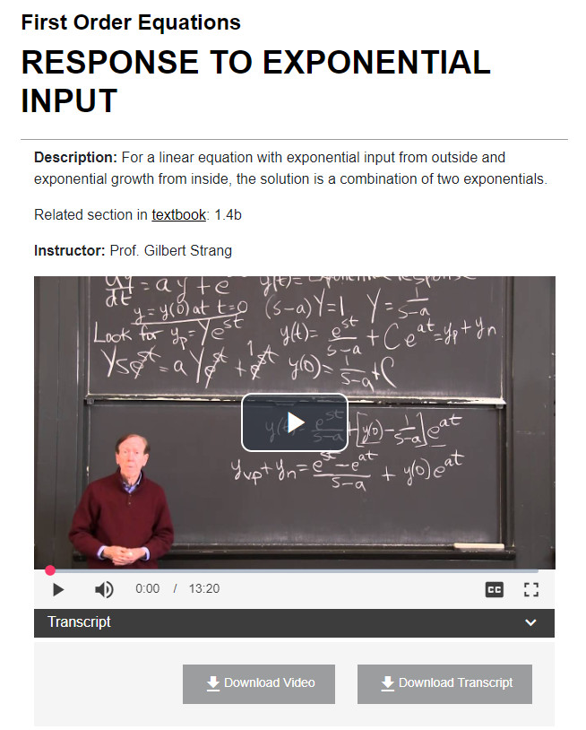
UDL in action
MIT OpenCourseware
Textbook + short videos with transcript included
First Order Equations | Learn Differential Equations: Up Close with Gilbert Strang and Cleve Moler | Supplemental Resources | MIT OpenCourseWare. (2015). Licensed under a CC BY-NC-SA 4.0 International License
Notes:
Lauren
This is a screenshot of a video created by Professor Gilbert Strang at MIT. Professor Strang has an assigned textbook and has created short lecture videos to accompany sections in the text. His videos are chunked between 10-20 minutes and are posted on the MIT OpenCourseware site. Each video has closed captioning, as well as an option to download the video or transcript (so it can be watched/read without an internet connection).
Some benefits of this approach:
-Videos and other resources were developed over time
-Once posted, they’re a reusable resource for many quarters/semesters to come
-The transcript is keyword searchable so students can jump to a specific point in the lecture to do targeted studying

Slide 10
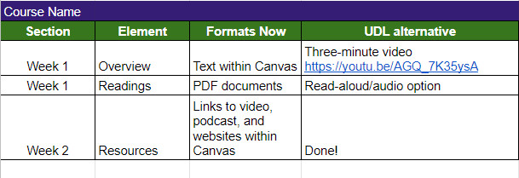
Tracking course material offerings
Adapted from “Media & Text Path Assessment” in Tobin, & Behling, K. T. (2018). Reach Everyone, Teach Everyone: Universal Design for Learning in Higher Education. West Virginia University Press. Included on the basis of Fair Use as described in the Code of Best Practices for Fair Use in Open Educational Resources.
Notes:
If you’d like to eventually add new streams of content for every section of your course, you could create a chart to organize those changes. This is an example that has been adapted from the book Reach Everyone, Teach Everyone: Universal Design for Learning in HIgher Education.

Slide 11
Different Modalities
Core element of multiple means of representation: presenting information in different ways!
Text, video, audio, graphics, interactive activities, and more; there are many options (especially online)
This presentation includes:
Text
Images
Audio/video (live speakers)
No recorded audio or video
Interactive elements
Notes:
Christine: the central feature of MMR is presenting information in different modalities. There are numerous options, especially when you have an online course site to utilize! Text, video, audio, graphics, interactions, websites can all be used during class and as assigned, out-of-class resources.
As an example, when creating this presentation, Lauren and I chose to include text and images, as well as audio and video in the form of live speakers. We deliberately didn’t include any pre-recorded audio or video, such as a YouTube video embedded in the PowerPoint, because we know from experience that playing a video like that through a Zoom call often doesn’t go well! You don’t have to use every single resource format that’s available to you. Think about what is the best fit for your class and your information.

Slide 12
Finding Different Modalities
Finding new resources in new modalities can feel overwhelming. Here are a few places to start!
Crash Course on YouTube
TED or TEDx Talks
OER Libraries
Industry Blogs
NPR Podcasts
Notes:
Christine: Just finding a textbook for a course can be a challenge. Adding in the possibility of every other type of media can make the process seem almost impossible! Here are a few places you can start looking for resources. We’ll have links in our handout and on the Canvas site.
CrashCourse: long-running YouTube channel with video series on a huge variety of educational topics (history, math, chemistry, philosophy, linguistics)
TED or TEDx: speakers presenting talks on a huge range of subjects
OER Libraries: Open Educational Resources are openly licensed free teaching materials that are intended to be widely distributed and modified to fit the particular needs of instructors. Available through NU libraries (Lauren can help you find specific resources!), as well as through OER-specific digital libraries
Industry Blogs: look for blogs related to the industries or fields that your students will go into for current topics, graphics, and stories
NPR Podcasts: numerous high-quality podcasts on a wide variety of topics including news, culture, science, and business

Slide 13
Consider Your Sources
How old is your source? Is something more recent or relevant available?
If you’re keeping an older resource, provide context for why this is the best one.
Who is (and isn’t?) represented among the creators of your resources?
Are all your authors or video presenters white, men, or white men?
What does the makeup of your creators tell your students about who is included in the field?
Can you find resources from a more diverse spread of creators?
Notes:
Christine: The modality isn’t the only thing you should consider when you’re picking a resource, though. On the pre-work worksheet, we asked you to include the publication year and the authors or creators of your resources. Those are important elements to think about as well.
Age of resource: how old is it? Is something more recent/relevant available? If it’s an older resource, contextualize why this is the best one to refer to
Diversity of resource creators: who is (and isn’t) represented among the creators of your resources? Are all the authors or video hosts white, men, or white men? What does that tell your students about who is welcome in the field? Make an effort to find sources from a diverse spread of creators

Slide 14
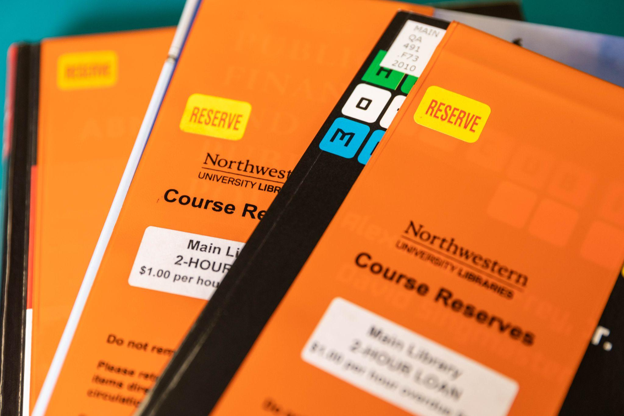
Before Class
Make required course information available to students in a timely manner
Put any physical textbooks on Course Reserve at the library
Post lesson goals
Post presentation slides (plus notes)
Check materials to ensure accessibility
alt tags, structured text, closed captioning
Notes:
Lauren
Some additional quick tips that you can implement before class:
Make course material requirements available to students in a timely manner. The 2008 Higher Education Opportunity Act requires instructors to provide course materials information in a timely manner so that students have the opportunity to understand the costs of a given course, it gives them time to comparison shop for texts, and enables them be prepared on the first day of class. In addition, if a student has a disability and needs special accommodations, the conversion process of print materials to accessible digital ones can take time. When you’re listing your course materials be sure to:
List all editions of a textbook that are acceptable.
Include information about access codes and software, if those will be required
If all materials will be provided at no charge via Canvas, state that within CAESAR.
If you’re curious about the next deadline for course material information in CAESAR, it is November 7!
If you haven’t already, you should also check with your library to see if they offer course reserve services. Course Reserve allows for shorter check out times so students can come to the library, check out the textbook for free, read the assigned chapters and return the book. This saves students money, guarantees at least one point of access to the materials, and gives students the option of using the free scanners that are available throughout the building.
It’s also good practice to post your lesson goals. You could do this in the learning management system, in the classroom, or even by asking students to write lesson goals down in their notebooks.
Providing lesson goals helps the students know what they’re hoping to achieve. If you make lesson goals available in multiple places, and reinforce during your lecture, it will help to ground students’ learning.
If you use presentation slides, make them available to students before class, if possible.
Prior to class, you’ll also want to check all materials to ensure accessibility
Check out the session “Tools for Making Your Digital Course Materials Accessible, Flexible and Usable for All” to take a deep dive into accessibility best practices
Utilize accessibility checkers within the apps you use: Microsoft Word, PPT, Google Slides, and Adobe all have built in accessibility checkers to help you make your documents accessible to students.
At Northwestern, we provide access to accessibility tools such as SensusAccess, which converts inaccessible materials into an accessible format. You may consider using this tool prior to uploading PDFs to Canvas.

Slide 15
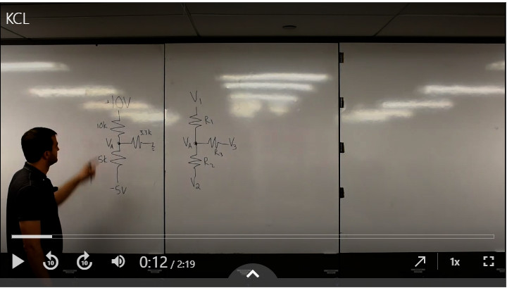
During Class
Digital Learning’s Panopto Information Page
Video Production Studio (Mudd Library)
Notes:
Lauren
Lecture capture recordings are a key UDL strategy, and research has shown that students who review lecture recordings better retain and understand the material presented. When you record a lecture, depending on the tool you use, it generates a transcript that will be used for closed captioning, and can be posted later on Canvas. Transcripts are keyword searchable, which allows students to find the section of the video they want to watch again.
Once you record videos, they are available indefinitely for students to use each quarter or semester. In addition, recording short videos and assigning them as pre-class preparation could free up class time to do active learning activities.
So, how do you do it? Northwestern has two primary resources for lecture and video recording. The first is Panopto.
Panopto
Panopto provides live and on-demand video options that students can access and watch later via their web browser. It can be used to record you, your screen, a whiteboard, a digital whiteboard, and even document cameras. There is a built in editor within the Panopto platform so you can easily edit and update your videos. Transcripts are automatically generated and can be exported as a text document. Videos can be integrated with Canvas and can be updated to your canvas course automatically.
Video Production Studio
Many universities are also offering “One Button Studios” or video production studios, giving faculty and instructors the ability to create professional quality instructional videos, without the need for in depth training. At Northwestern, our video production studio gives instructors two recording options: lightboard mode and self-service mode.
Lightboard mode uilizes a glass chalkboard that uses light to allow users to face viewers while writing and recording a lecture. Created by Northwestern Engineering Professor Michael Peshkin, the board is videotaped in mirror reflection, giving users a quick and easy way to communicate technical subjects, equations, and sketches, all while engaging with the camera and the viewers.
Our self service model is also available, and that offers an easy way to record a presentation or lecture, deliver a research presentation, or to create an instructional demonstration videos within a studio space.
Reach out to your IT or Digital Learning team to learn more about your options for video production at your institution.
Jovan F. Groen, Brenna Quigley, and Yves Herry, "Examining the Use of Lecture Capture Technology: Implications for Teaching and Learning," Canadian Journal for the Scholarship of Teaching and Learning 7, no. 1 (2016). ↩
Ron Owston, Denys Lupshenyuk, and Herb Wideman, "Lecture Capture in Large Undergraduate Classes: Student Perceptions and Academic Performance," The Internet and Higher Education 14, no. 4 (2011), 262–268. ↩
Optimal length of instructional video: 6 minutes or shorter: https://blog.edx.org/optimal-video-length-student-engagement

Slide 16
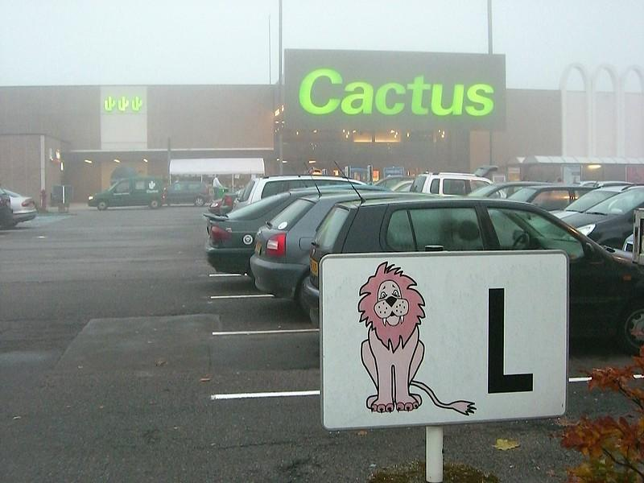
During class
Offer visual imagery or mnemonic devices when explaining concepts
Embed new ideas in familiar contexts; draw on art, music, popular culture
Google doc for crowdsourced notes
“Mnemonic Device” by Kristina D.C. Hoeppner is licensed under a CC-BY-SA 2.0 License
Universal Design for Learning. Retrieved from https://www.rochester.edu/college/disability/faculty/universal-design.html
UDL: Representation. Retrieved from https://udlguidelines.cast.org/representation
Notes:
Here are some other quick strategies that you can offer during class:
Offer visual imagery or mnemonic devices when explaining concepts
Embed new ideas in familiar contexts; draw on art, music, popular culture
Use a Google doc so students can crowdsource lecture notes. It can be a useful ongoing document for students to reference, and will be illuminating for you as an instructor to see how students are interpreting your lecture.

Slide 17
After Class
Reinforce learning and share materials online
Post lecture notes
Ask students to find and share their own resources
Identify pinch points and create resources to support students
Resources are reusable in the future!
Notes:
Christine
Post lecture notes; could be an outline, class notes, etc. (not necessarily slides)
Ask students to share resources they find; you can use those in the future!
Utilize digital space; reinforce what happened in class, prep them for what’s coming next (in addition to posting materials)
Take note of where students seem to be struggling; if many students are asking about a particular topic, consider creating additional resources to support students (either for this class or in the future)

Slide 18
Multiple Means of Representation & Mental Health
Provide information in smaller chunks
Repeat information more than you would have previously (in multiple spots throughout a course site, for example)
Provide info in an audio format* to allow students to multitask, so they can listen to the weekly reading while on their commute, while preparing dinner, etc.
* Or in text that’s formatted properly for text-to-speech tools like Read&Write Gold
For longer resources (videos, texts, etc.), provide the ability to search through them so students can easily find information to refresh themselves
Supporting students through limited concentration, brain fog, anxiety, and time management challenges.
Notes:
Christine: These strategies apply at all points of the course, and are based on trends seen as we move into Year 3 of the pandemic.
Provide info in smaller chunks, repeat info more than you would have previously
Providing info in audio format* can allow students to multitask (listen to weekly reading on their commute or while making dinner, etc.)
Provide ability to search through longer resources (videos, texts, etc.) so students can zero in on info they need to refresh themselves; easier to look up a key term with a transcript search than rewatching a 30-minute video
*Or in an accessible text format that students can turn into audio on their own; Read&Write Gold

Slide 19
What’s Next?
Check out these resources:
UDL on Campus (CAST)
Multiple Means of Representation (CAST)
Look for single streams of content in your course
Add one additional format
Start small!
Notes:
http://udloncampus.cast.org/home
https://udlguidelines.cast.org/representation

